Slide 1
Usability Testing

Slide 2
Why Should You Care About Usability?
Have you ever…
  gotten lost in a Web site?
  left a site without finding the information you wanted?
  waited too long for a page to download?
  gone to a site you can’t view or read?
  visited a site with outdated information?
Do you want people to visit and return to your site?

Slide 3
Definitions
Usability is the measure of the quality of a user's experience when interacting with a product or system
    whether a Web site, a software application, mobile technology, or any user-operated device.

Slide 4
Evaluation: Usability Testing
What is Usability Testing?
  A way to evaluate the interface with real users.
  Can be done in a lab or in their environment.
  Can be performed on paper prototypes as well as implemented systems.
How?
  Give users representative tasks to complete.
  Watch for where the interface does not support their task completion.
  Identify changes to be made to the interface to support the user.

Slide 5
What (minimum) equipment do you need to formally test
Computer
Person to monitor the test participant:
  where they went,
  what they clicked,
  how long did it take…
A task, or list of tasks for the test participant to perform
Video camera (optimum: 2 cameras) to capture:
  Participant’s face
  Computer screen

Slide 6
Why videotape the session?
Documentation for other members of the development team
If something goes wrong, the test participant will have some reaction on face and on screen
Debriefing (end of session):
  Tester & monitor review session (run through video)
  Stop video at interesting points to discuss:
    Reasons participant performed the task the way they did
    What participant would like to happen

Slide 7
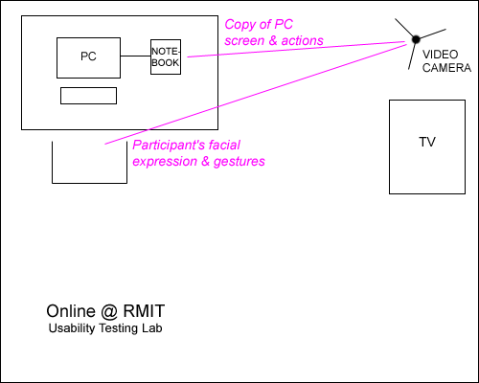
Layout of the room

Slide 8
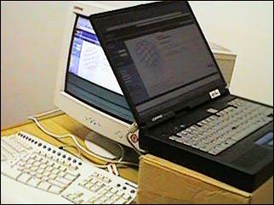
PC is connected to notebook. Notebook displays whatever happens on the participant’s PC

Slide 9
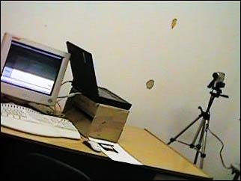
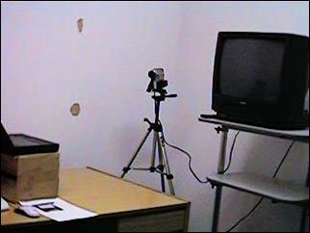
Video camera set to record notebook screen and participant at PC (ideal setup would have 2 cameras)

Slide 10
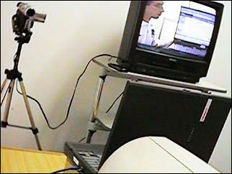
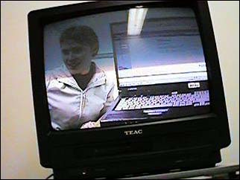
The TV shows the video camera recording… tester & test participant review this at the end of the session

Slide 11
How many people do you test?
5 people provide sufficient test results and feedback
  Group 1 (establishing benchmarks):
    5 novice users
    5 more experienced users
  Group 2:
    5 novice users after induction

Slide 12
How do you measure usability?
The product is usable if participants performed most of the tasks
Benchmarking (Group 1):
  Quantitative: n% testers took x minutes to perform task 2
  Qualitative: comments/discussion, e.g., if everyone had problem with a task, to highlight design flaws. Or positive feedback.

Slide 13
What happens with the results?
Results are tabled as a report (to development team)
Feeds back into the design process

Slide 14
Disadvantages
Emphasizes first-time usage and has limited coverage
Difficult to ascertain performance after regular usage

